Slide 1



Project Title
PROJECT MEMBERS
1.Boomadevi S [23ITR016]
2.Gowri D [23ITR048]
3.Arunprasad S [23ITR008]
JAIHARI D (19ITR028)
PROJECT GUIDE
Dr.Devisurya Asst.Prof

Slide 2

Challenge: Developing a functional and interactive chess game
Complexity: Requires implementing chess rules, move validation, and game state management.
User Requirements: Must support piece movements, game statistics, and user interaction.
Data Management: Need to store and manage chess pieces and board state efficiently.
Persistence: Save and load game states to support resuming games.

Slide 3
Objectives
Design: Create a comprehensive chess game with complete functionality.
Data Structures: Use arrays, linked lists, or other structures to manage the chessboard and pieces.
Validation: Ensure move validation adheres to chess rules.
User Interface: Develop a command-line interface (CLI) for game interaction and display.
3

Slide 4
Software / Hardware Tools used
Programming Language: Java
IDE/Editor: Visual Studio, JavaIDK
Libraries: Standard libraries for data structures and file handling.
Operating System: Windows
4

Slide 5
Implementation Details
2D Array: Representing the chessboard.
Class Hierarchy: For different chess pieces.
Doubly Linked List: To track game states for undo/redo.
Stack: To keep track of move history
ArrayList: To dynamically store potential moves.
Enum: For clarity and type safety when representing piece types.
5

Slide 6
2D Array
List
Graphics Object
Purpose:Represents the chessboard where each element can hold a piece
Dimensions: 8x8, corresponding to the 8 rows and 8 columns of a chessboard.
Purpose: Stores a list of valid moves for a player (either red or black). Each Move object contains information about a starting position and an ending position on the board.
Usage: Used in the getAllValidMoves method to keep track of all potential moves a player can make.
Purpose: Used for drawing the chessboard and pieces on the screen in the paint method and during user interactions. This is not a data structure in the traditional sense but is a Java AWT class that manages drawing operations on components.

Slide 7
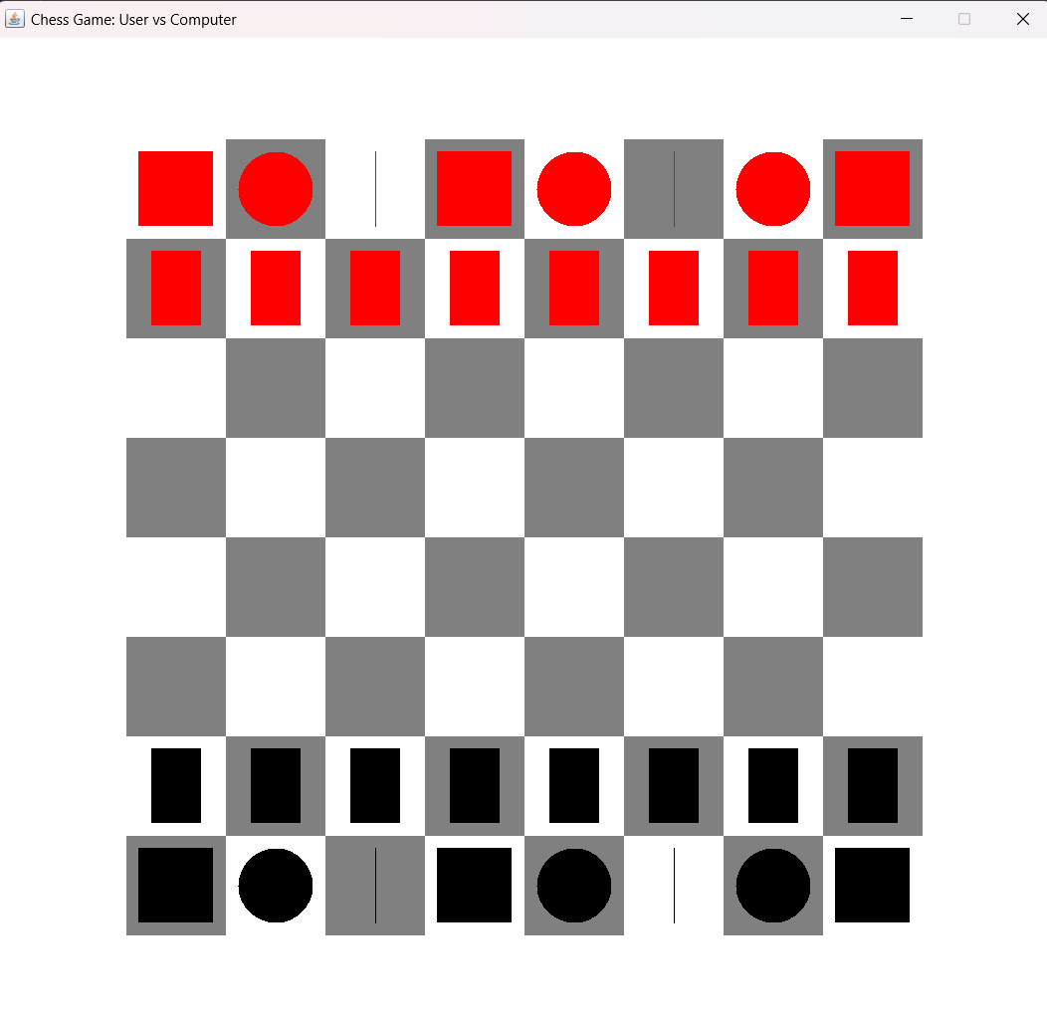
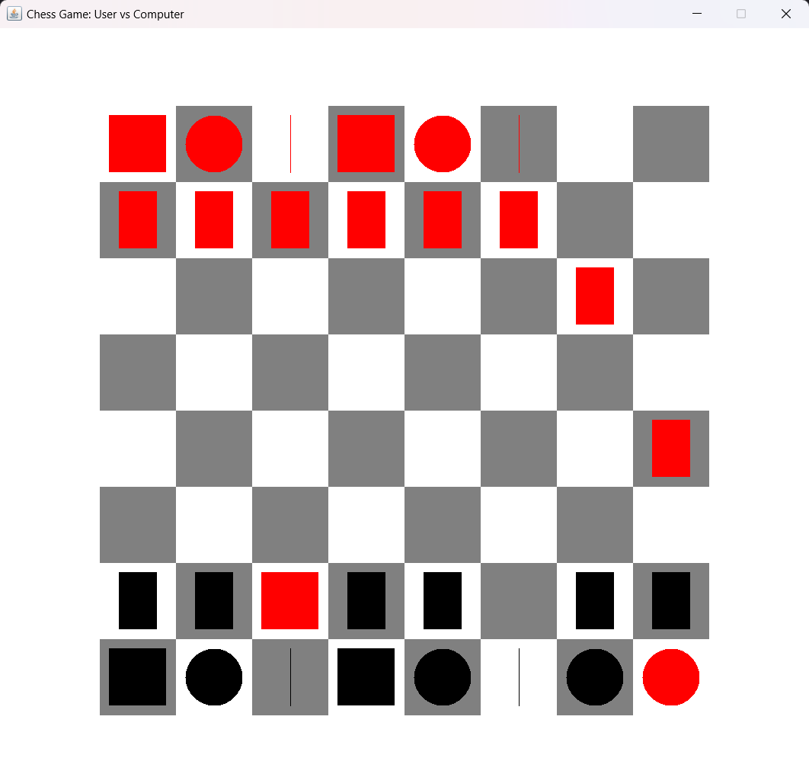

Slide 8
Thank you!

